Slide 1
LARIAT
RENT-A-CAR
1-800-555-9345
Recommendations on Optimizing Fleet to Grow Profits

Slide 2

Goals
Minimizing costs
Maximizing revenue
Identify sources of profit loss

Slide 3

Considerations
Revenue vs cost by car
How are accidents related to cost?
Are there accident-prone cars, locations, renters or times of year?
Which cars are rented the least?
Revenue by location

Slide 4

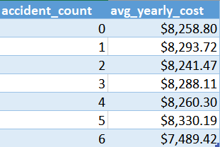
Results
There is not a significant correlation between more accidents and higher car cost, the cars with the most accidents have the lowest yearly cost.
The number of times a car is does not have a significant impact on revenue by car. Cars with 6 accidents a year have the lowest yearly cost.
Total yearly revenue only varies by 8% throughout all locations.

Slide 5

Key Factor
The key factor behind higher profits is the car’s make and model.
48.25% of cars in the fleet make a higher-than-average profit
The 55 lowest profit cars lose approximately $58,000 annually
Top 5 makes and models:
2017 Mitsubishi Eclipse
2018 Chevrolet Beretta
2017 Isuzu Ascender
2018 GMC Savana
2016 Pontiac Firebird

Slide 6

Definitions
Fleet Reduction Percentage removes the cars with the lowest profit starting with the least profitable car.
Fleet Growth Percentage adds the cars with the highest profit starting with the most profitable car.
The 2019 Projected Profits include the cost of the initial down payment for new cars added to the fleet. The 2020 projected profit does not include this cost.
Projected Growth Rate: 23.3% is the projected annual growth for car rentals in the United States.

Slide 7
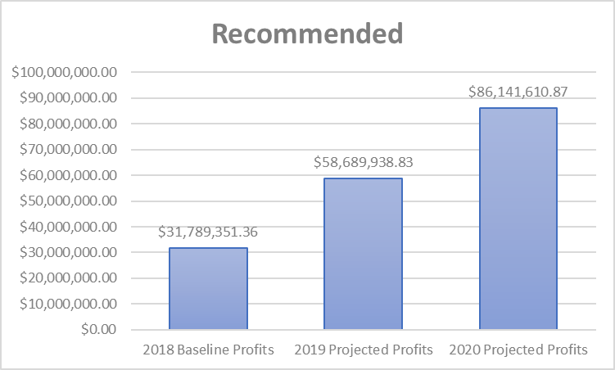
Recommendations
20% Fleet Reduction
45% Fleet Growth
23.3% Growth Rate
Following these recommendations leads to:
Projected growth of 85% in 2019
Additional 86% in 2020

Slide 8

Thank You!
Alexandra Durec
alexandradurec@gmail.com
alex-durec on LinkedIn and GitHub

